Slide 1
Random-Intercept Models
EDUC 8825 Advanced Data Analysis
W. Joel Schneider

Slide 2
Effect | Definition | Example
Fixed | Specified Number of Groups with Theoretically Important Mean Differences | Treatment vs. Control
Random | Large and Potentially Infinite Number of Groups with Uninteresting Mean Differences | Unexplained Differences Between Teachers

Slide 3
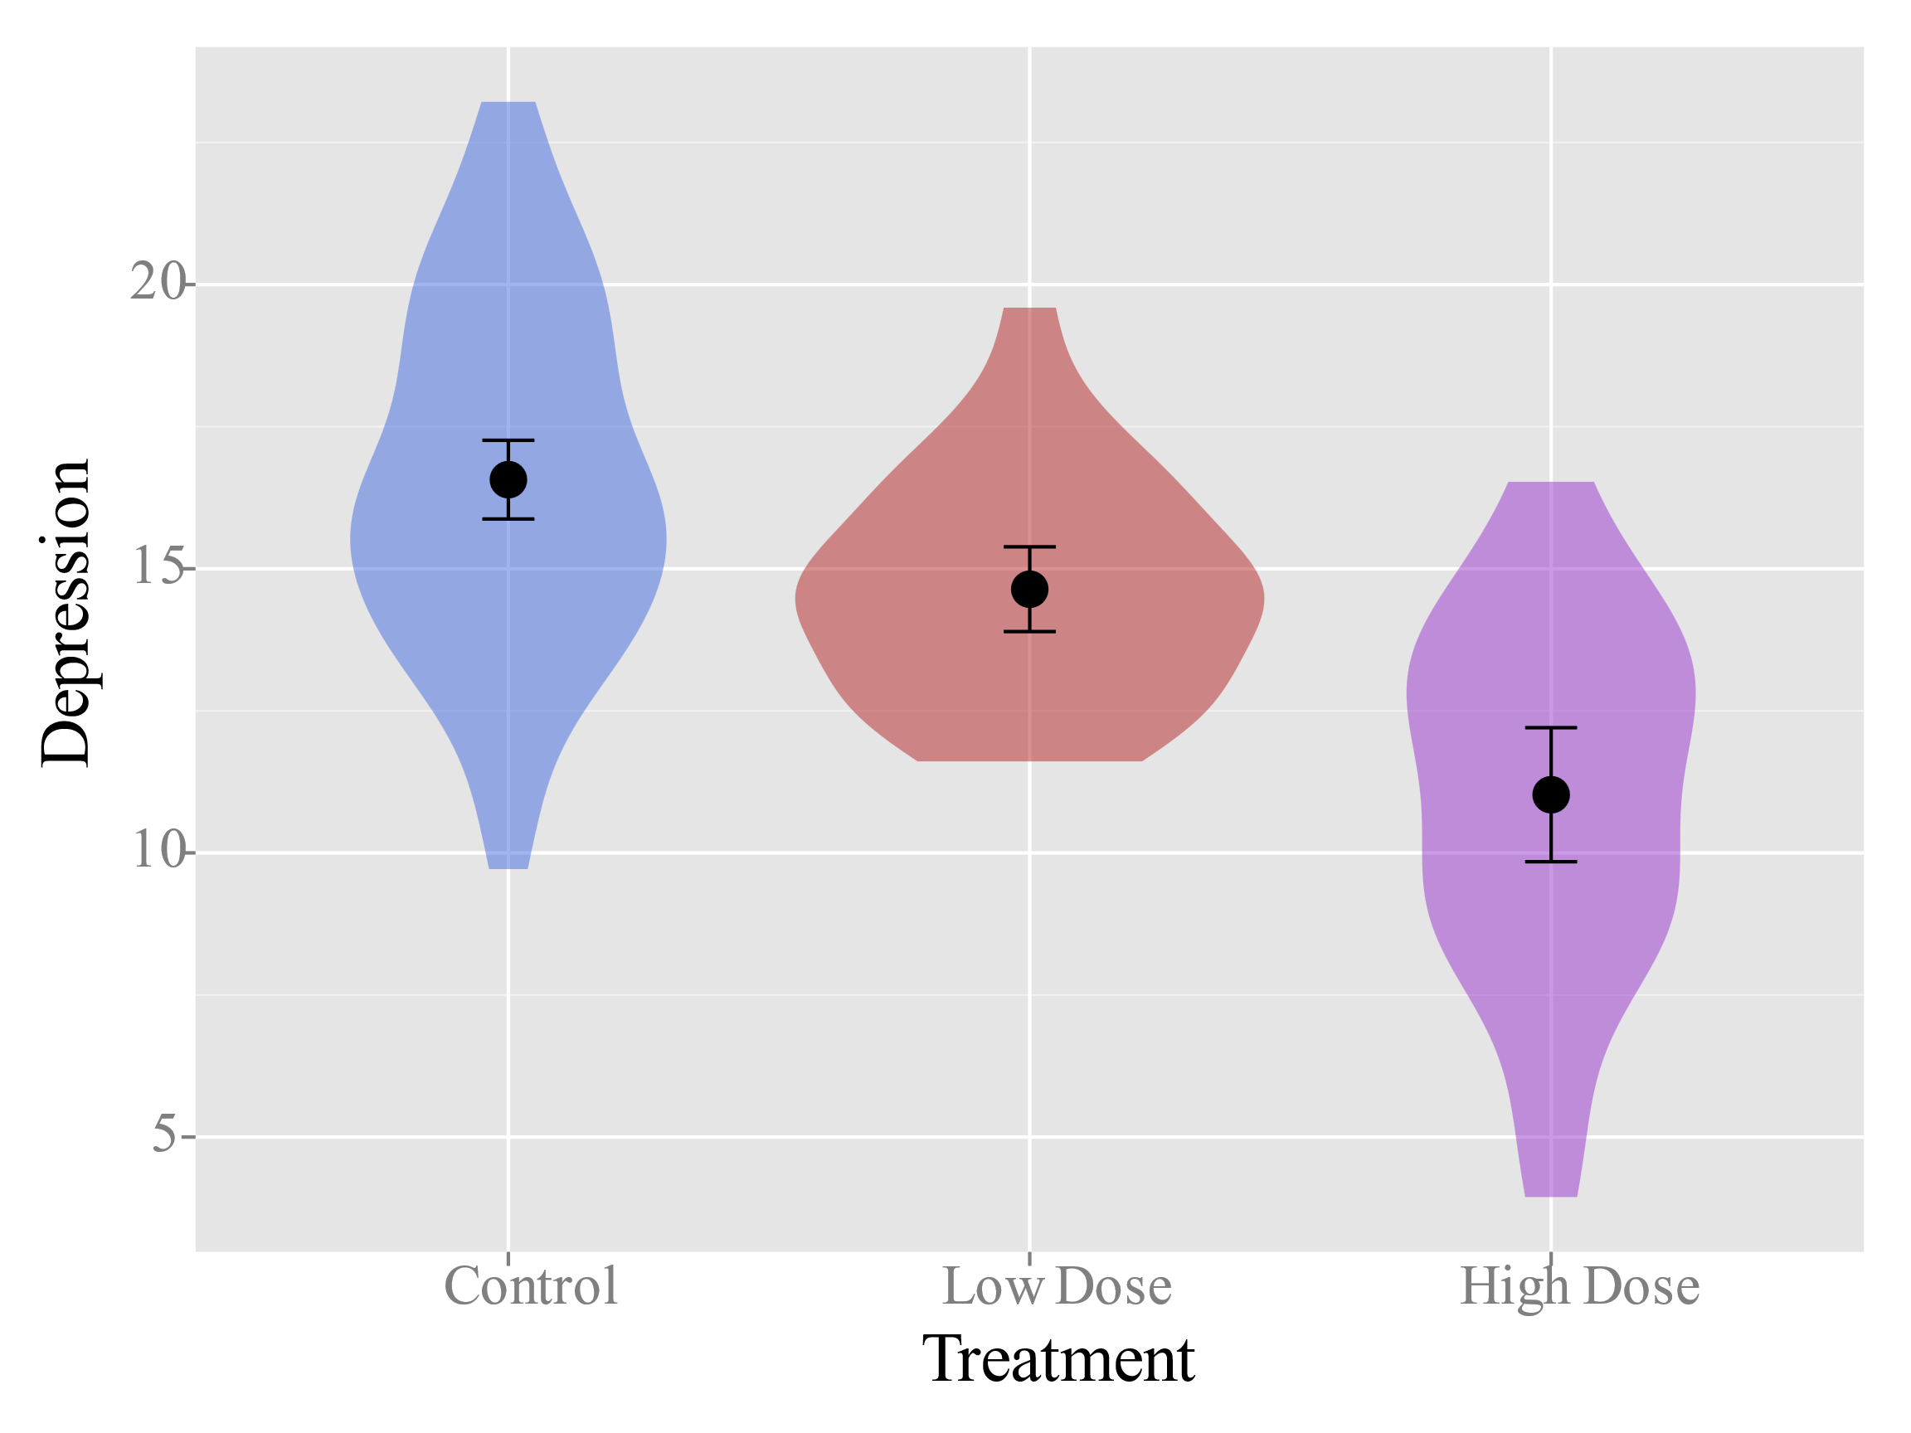
Fixed Effect of Treatment on Depression

Slide 4
Reading Intervention Study
A Cluster-Randomized Controlled Outcome Study
H₁: Students in the Treatment Group Will Have Higher Reading Comprehension Scores Than Students in the Control Group.
900 Students in 30 Classroom
16 Classrooms in Control Group
14 Classroom in Treatment Group

Slide 5
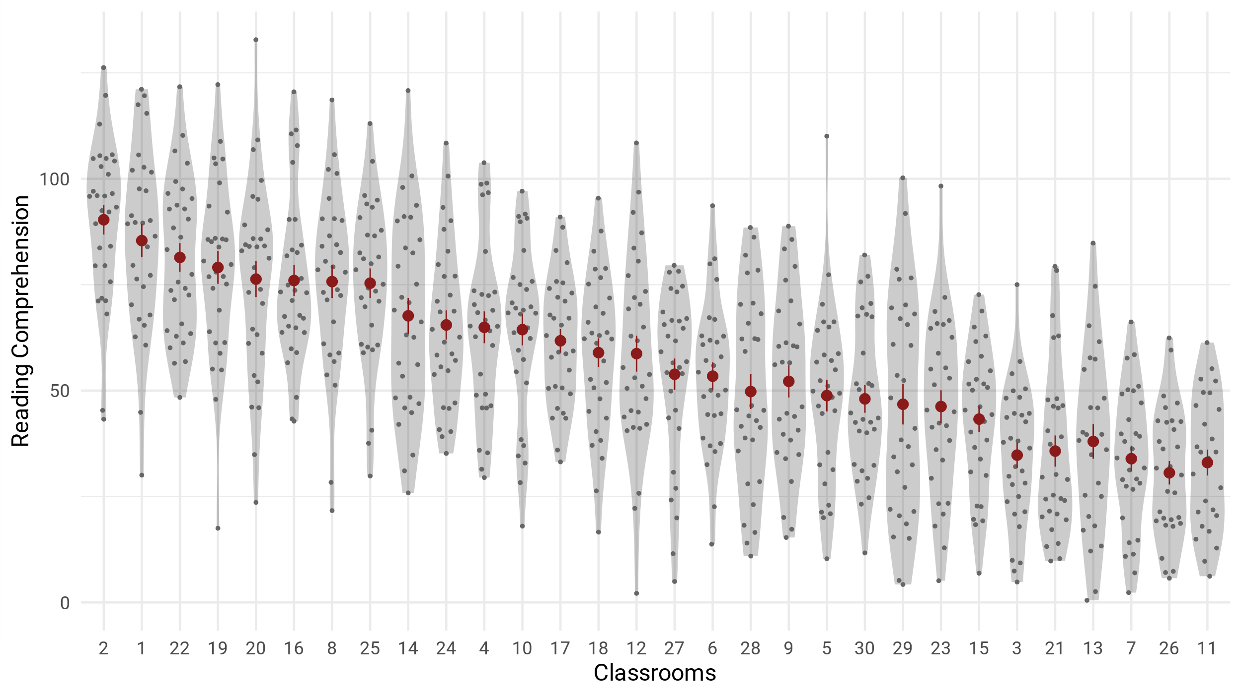
Random Classroom Differences in Reading Comprehension

Slide 6





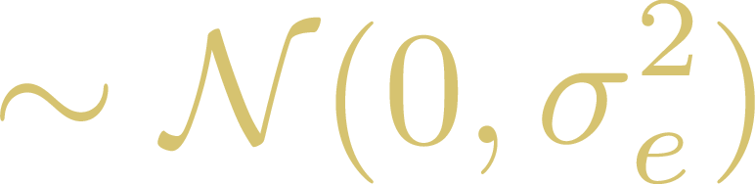




Model 0 = Random Intercepts
Deviation from Overall Intercept for Class j
Overall Intercept
Level 2
Deviation from
Prediction for Person i in Class j
Reading Score for Person i in Class j
Intercept for Class j
Level 1

Slide 7


Model 0 = Random Intercepts
Intraclass Correlation:
Variance Explained by Random Intercepts
Deviation from
Prediction for Person i in Class j
Deviation from Overall Intercept for Class j
Reading Score for Person i in Class j
Overall Intercept
Mean for Classroom j

Slide 8
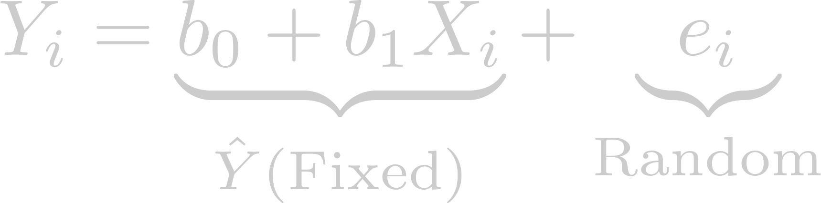
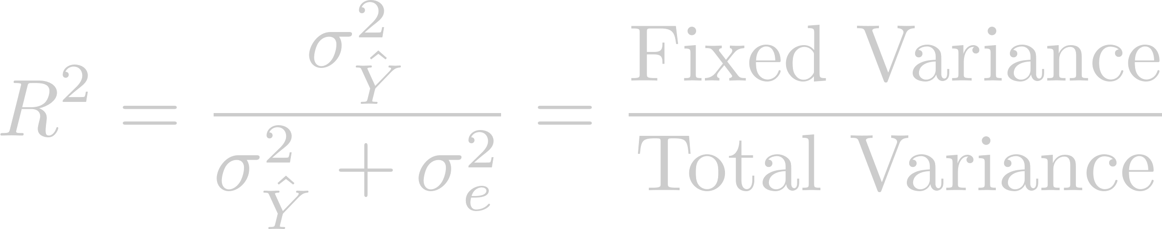
Variance Explained in Ordinary Least Squares Regression

Slide 9
Model 0 = Random Intercepts
Intraclass Correlation:
Variance Explained by Random Intercepts
Deviation from
Prediction for Person i in Class j
Deviation from Overall Intercept for Class j
Reading Score for Person i in Class j
Overall Intercept
Mean for Classroom j

Slide 10
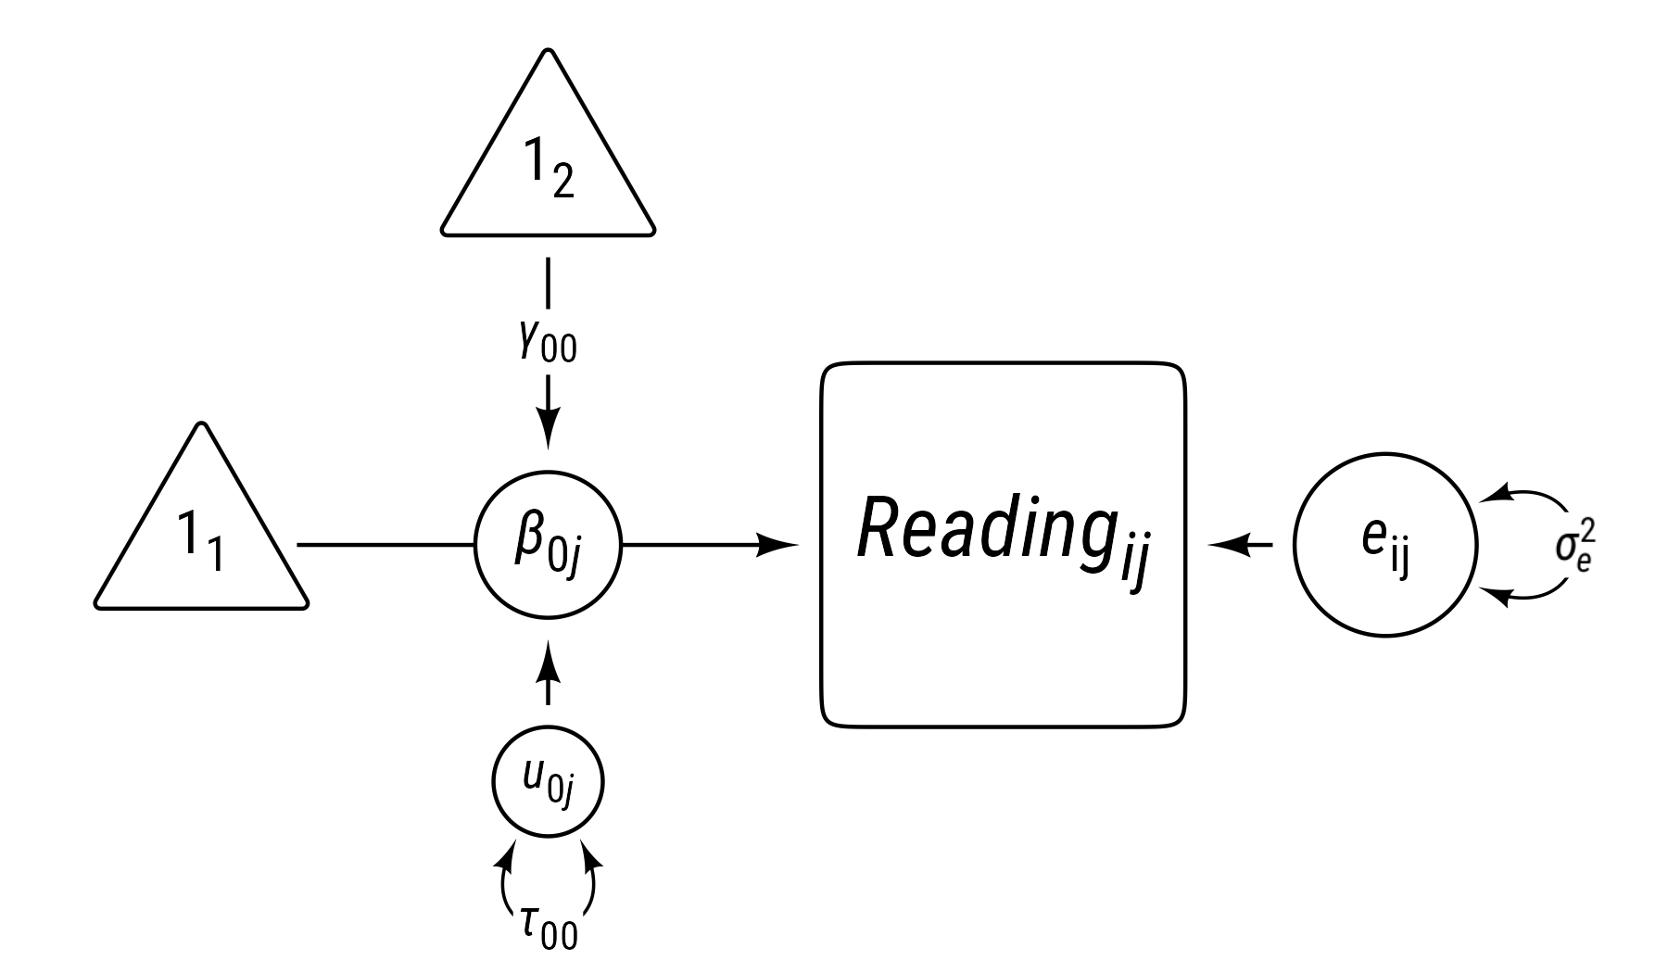
Model 0 = Random Intercepts
Random Intercept (β_{0j} )
Level 2 Group
R Syntax:
lmer(reading ~ 1 + (1 | class_id))
Outcome
Fixed Intercept (γ₀₀)
Deviation from Overall Intercept for Class j
Deviation from
Prediction for Person i in Class j
Reading Score for Person i in Class j
Overall Intercept
Fixed
L2 Random
L1 Random

Slide 11
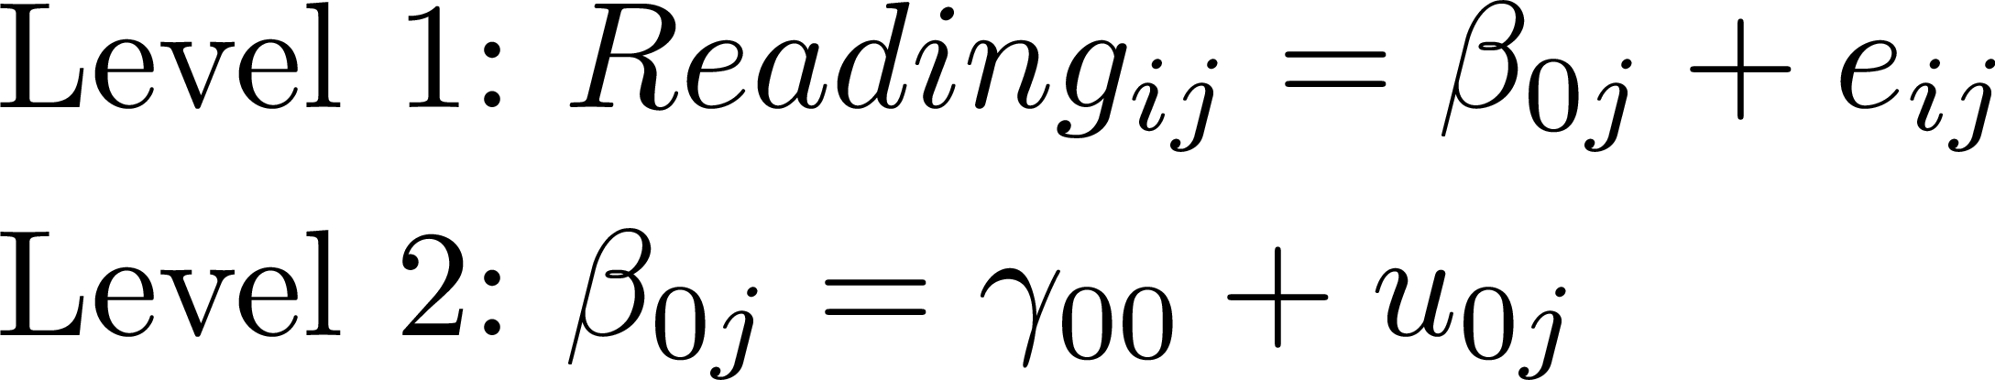
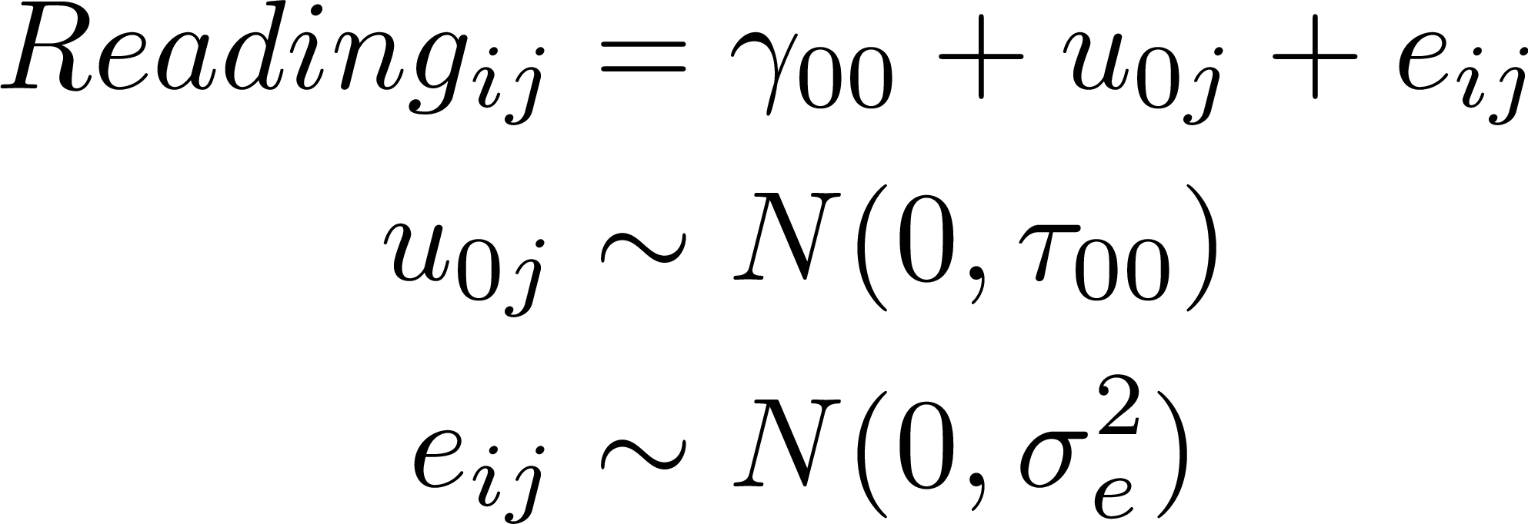
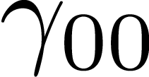
Random Classroom Differences in Reading Comprehension

Slide 12
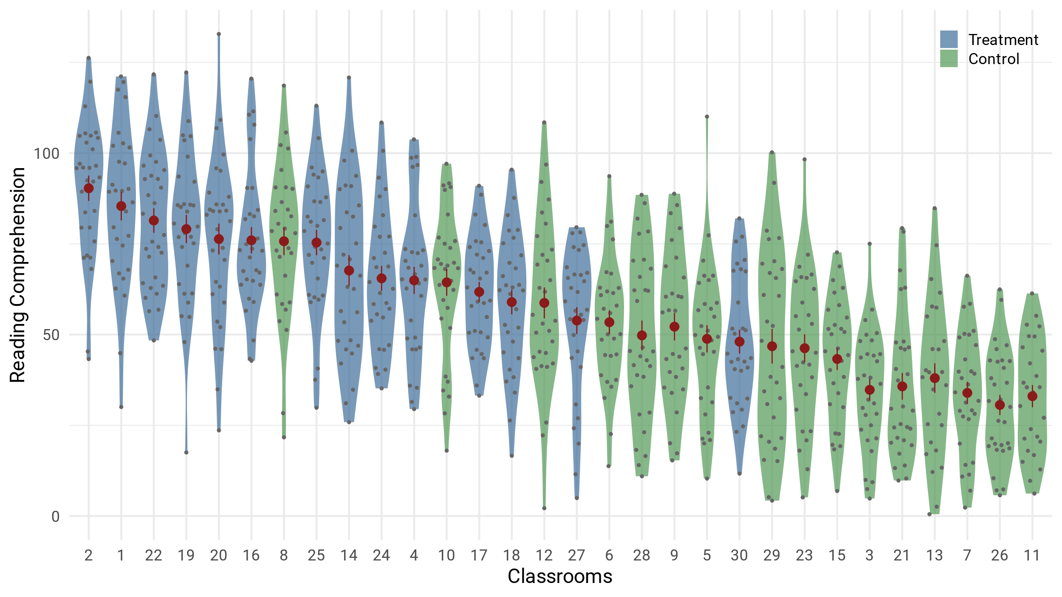

Slide 13
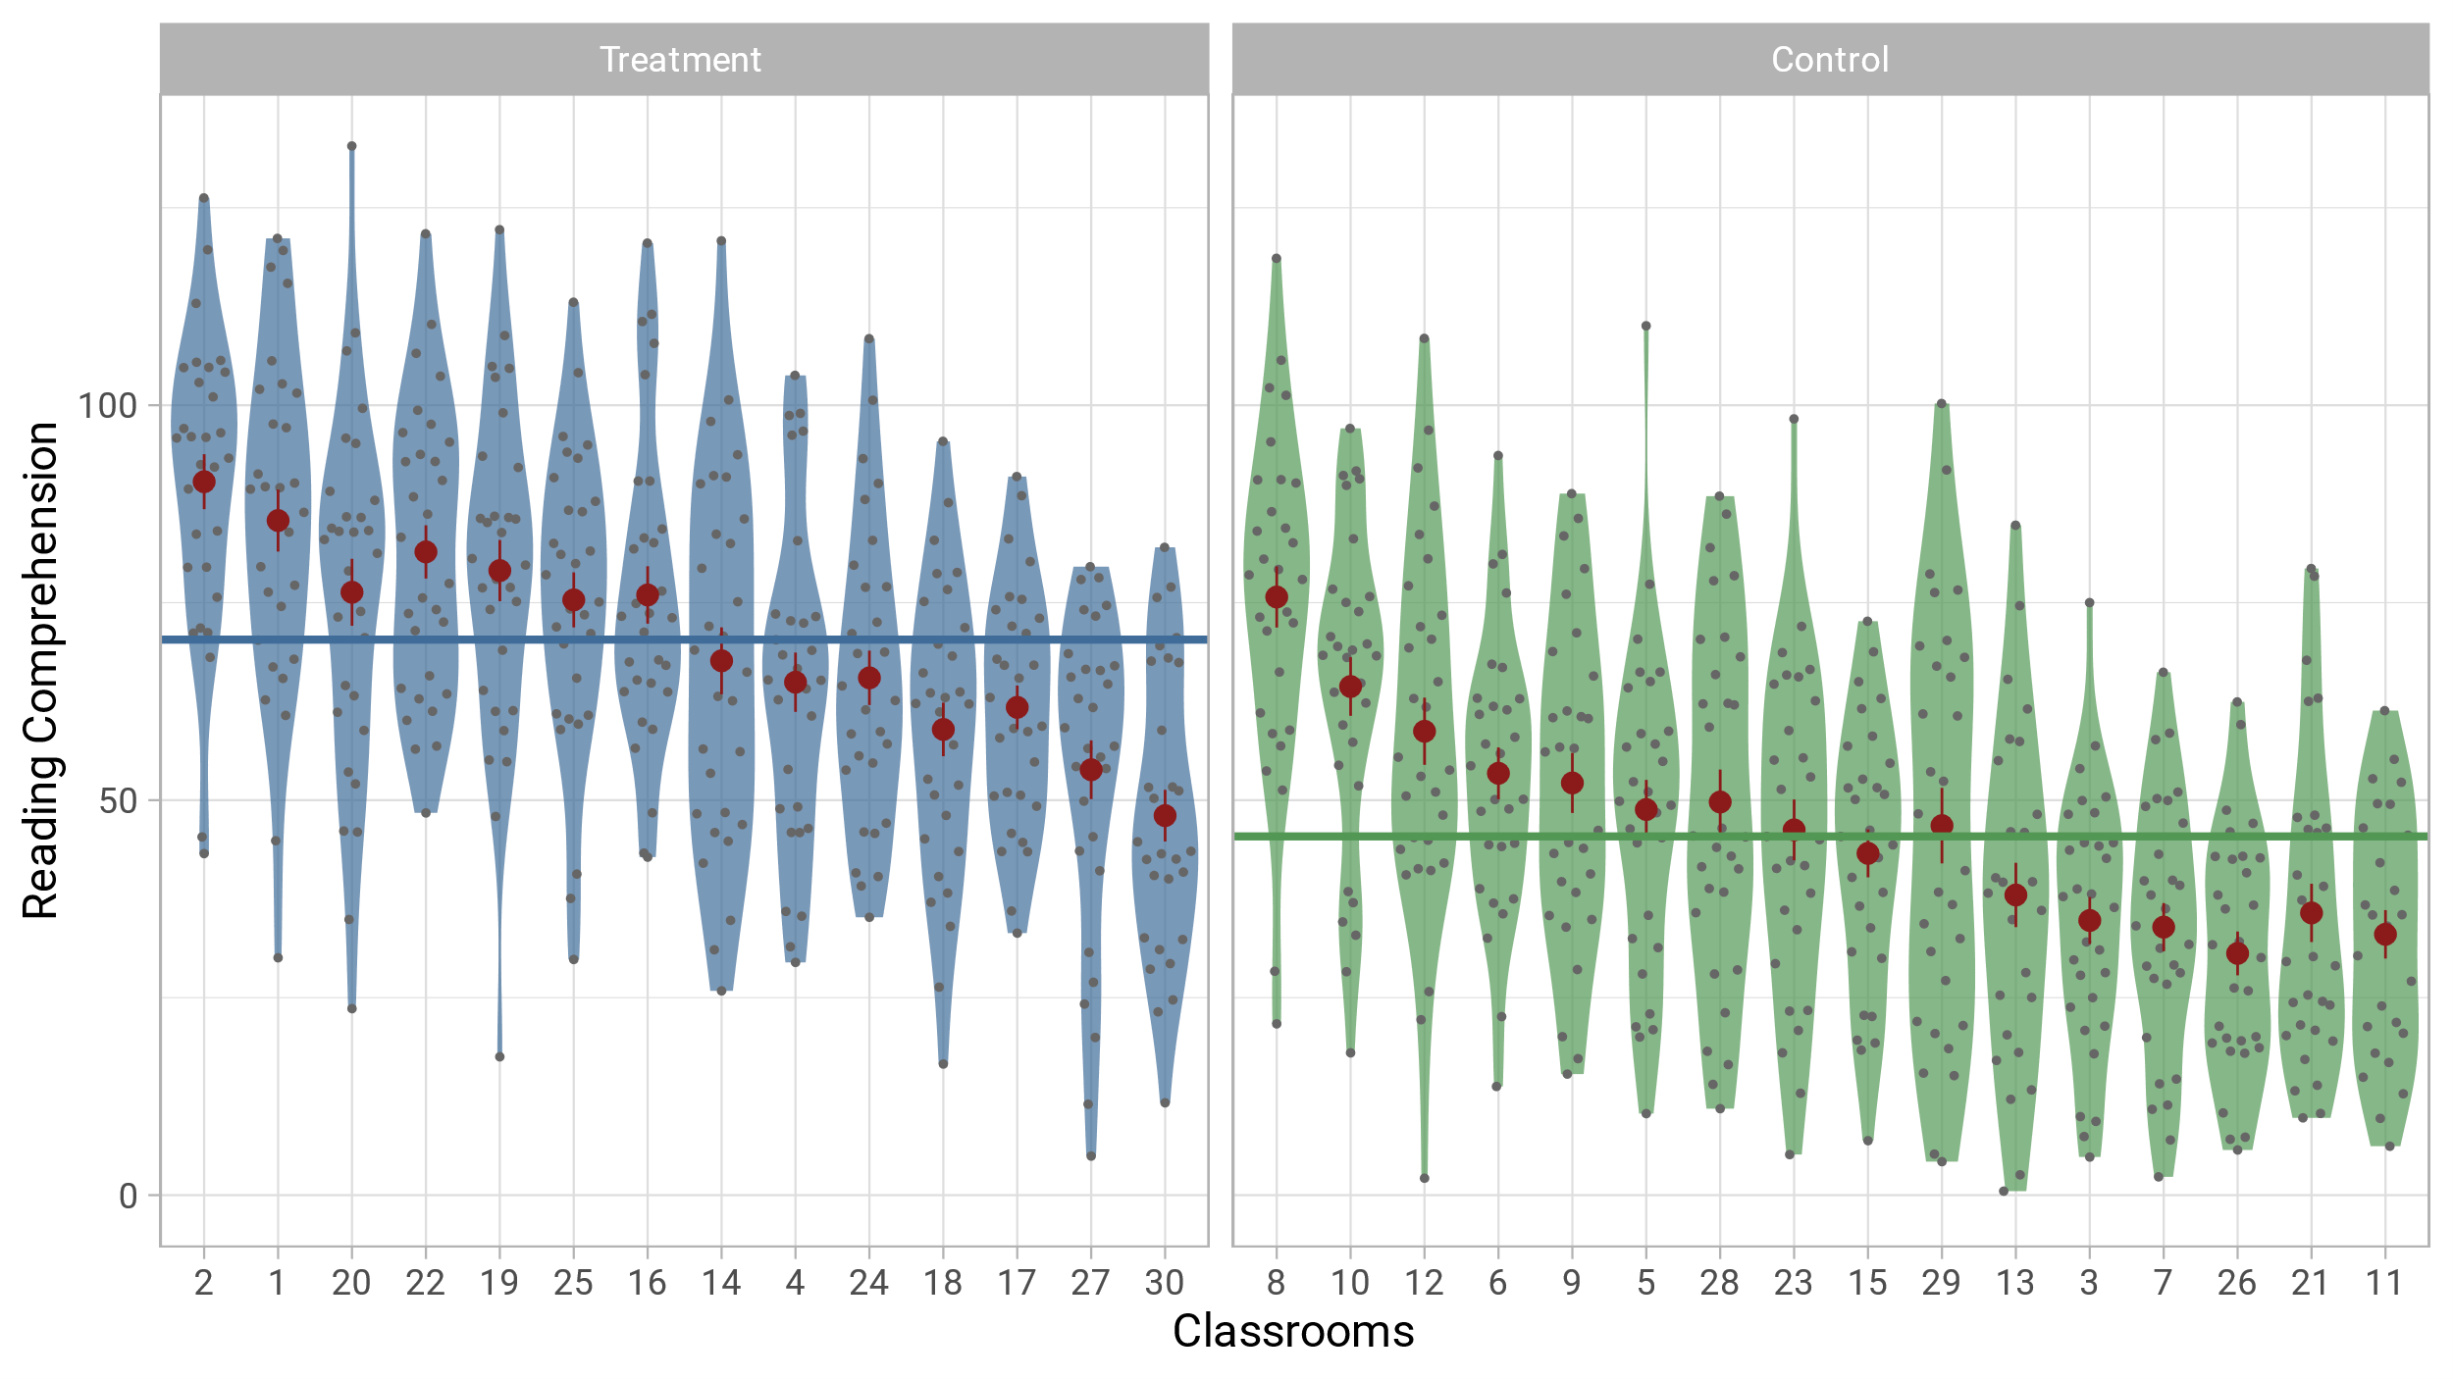
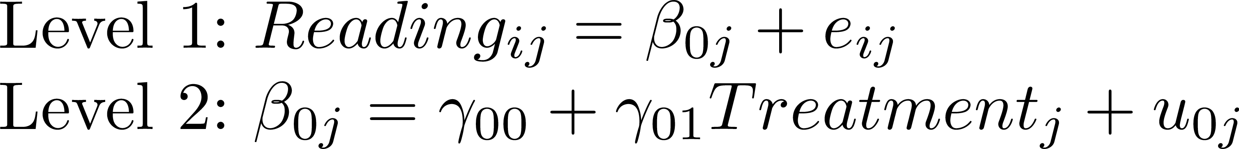
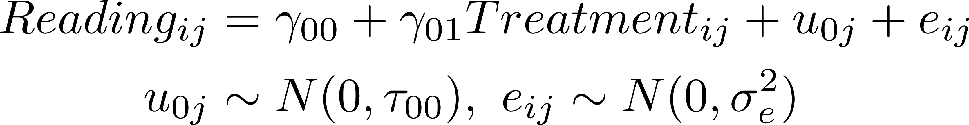

Slide 14




Means as Outcomes Model 1 = Model 0 + Treatment
Level 2
Deviation from Overall Intercept for Class j
Fixed Intercept
Treatment Variable for Class j
Fixed Effect for Treatment
Deviation from
Prediction for Person i in Class j
Intercept for Class j
Level 1
Reading Score for Person i in Class j

Slide 15
Means as Outcomes Model 1 = Model 0 + Treatment
Deviation from Overall Intercept for Class j
Deviation from
Prediction for Person i in Class j
Treatment Variable for Class j
Fixed Intercept
Fixed Effect for Treatment
Reading Score for Person i in Class j
Control Group Mean

Slide 16
Means as Outcomes Model 1 = Model 0 + Treatment
Deviation from Overall Intercept for Class j
Deviation from
Prediction for Person i in Class j
Treatment Variable for Class j
Fixed Intercept
Fixed Effect for Treatment
Reading Score for Person i in Class j
Treatment Group Mean

Slide 17
Means as Outcomes Model 1 = Model 0 + Treatment
Deviation from Overall Intercept for Class j
Deviation from
Prediction for Person i in Class j
Treatment Variable for Class j
Fixed Intercept
Fixed Effect for Treatment
Reading Score for Person i in Class j
Mean for Classroom j

Slide 18
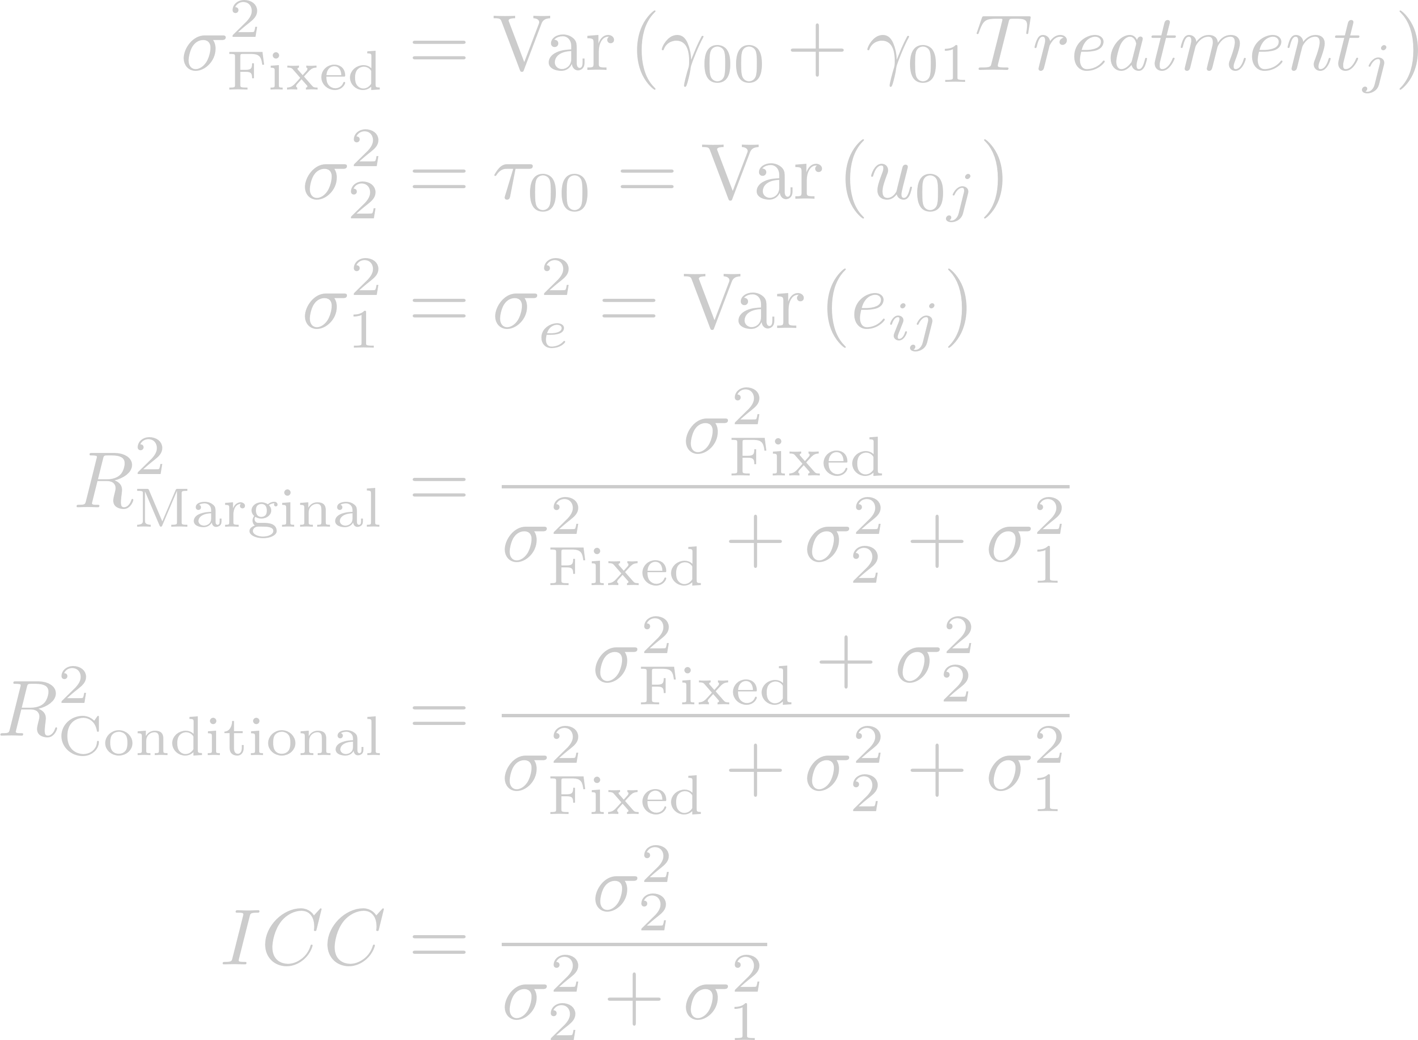
Means as Outcomes Model 1 = Model 0 + Treatment
Deviation from Overall Intercept for Class j
Deviation from
Prediction for Person i in Class j
Treatment Variable for Class j
Fixed Intercept
Fixed Effect for Treatment
Reading Score for Person i in Class j
Fixed
Level 2
Level 1

Slide 19
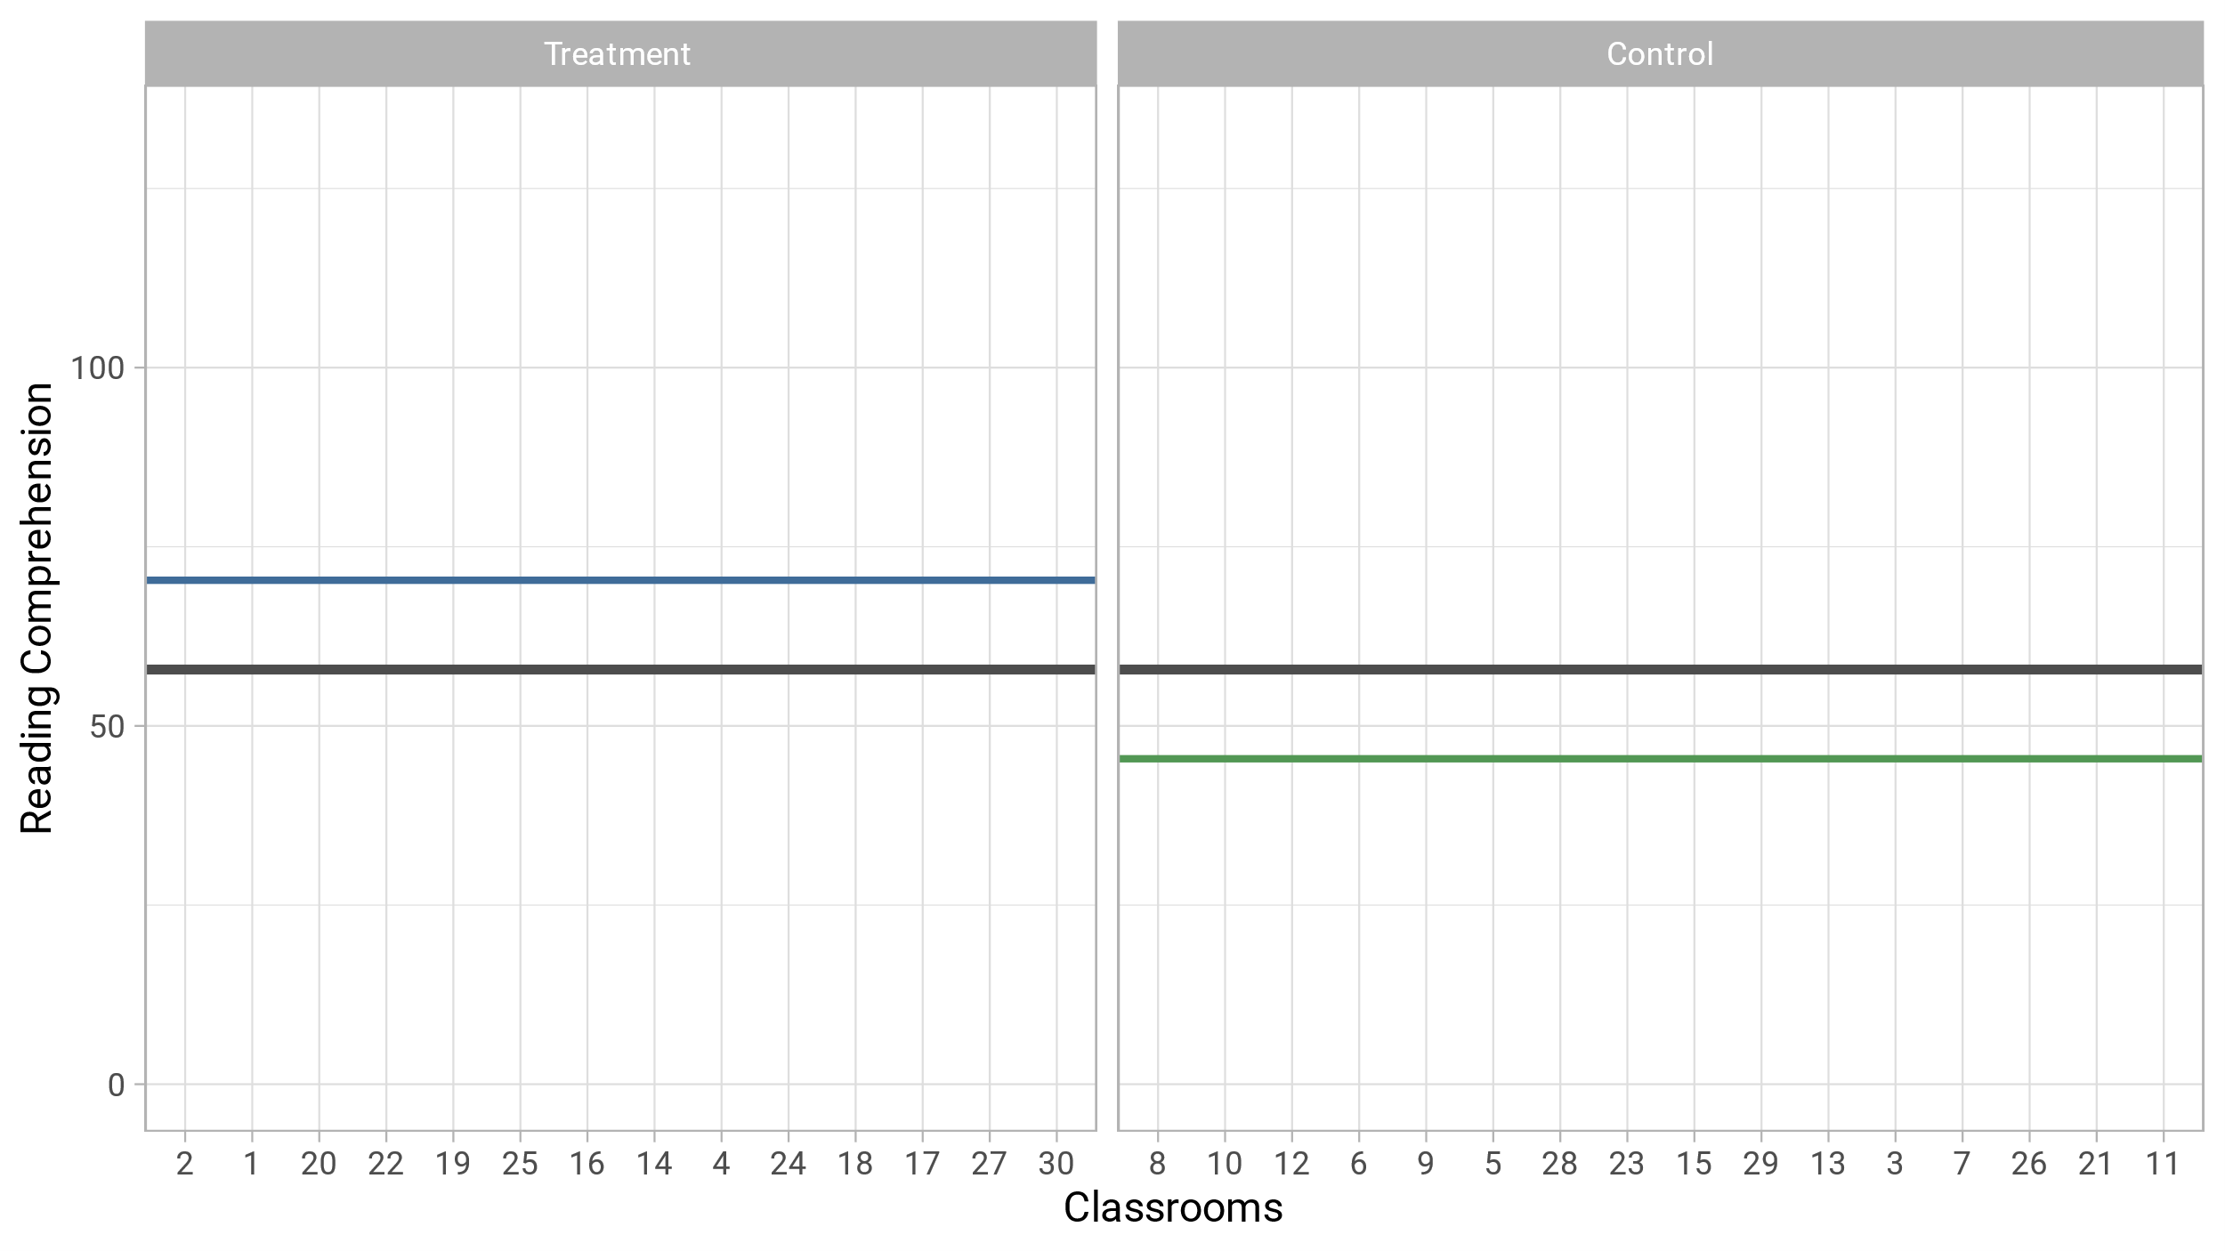

Slide 20
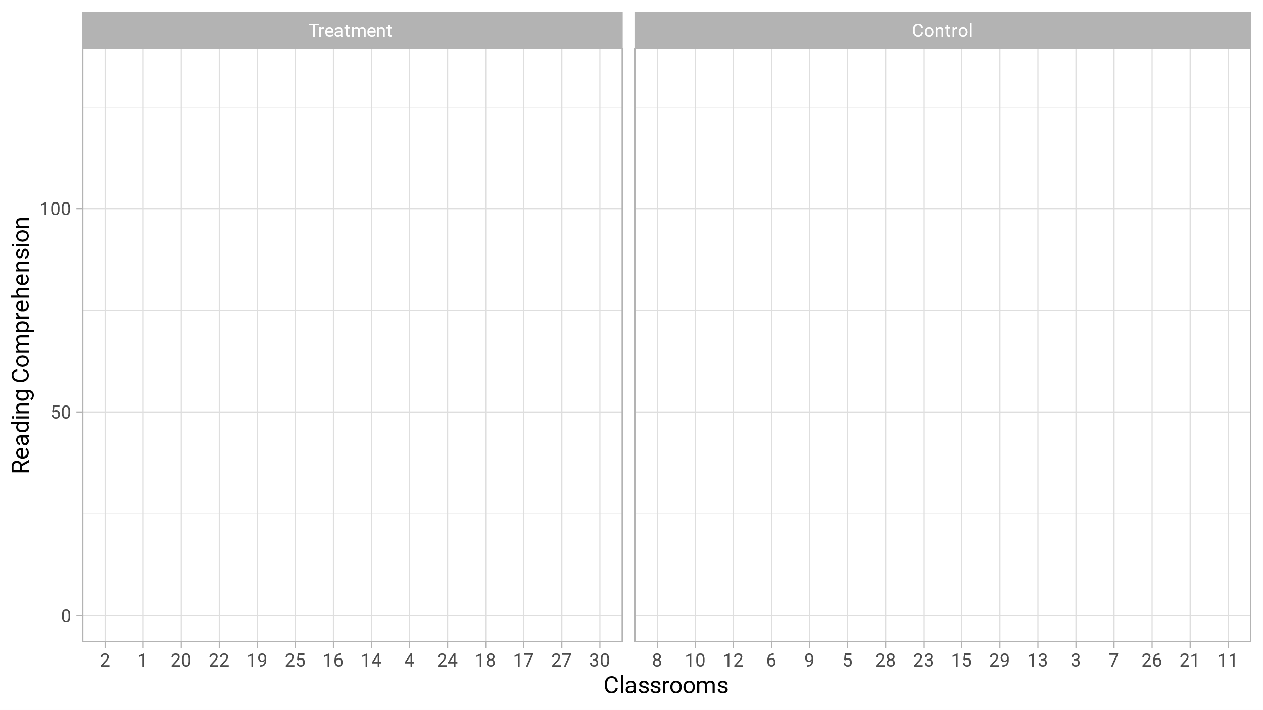

Slide 22
Level 2 Variance Reduction
How much does τ₀₀ shrink from Model 0 to Model 1?

Slide 23
Level 2 Variance Reduction
How much does τ₀₀ shrink from Model 0 to Model 1?

Slide 24
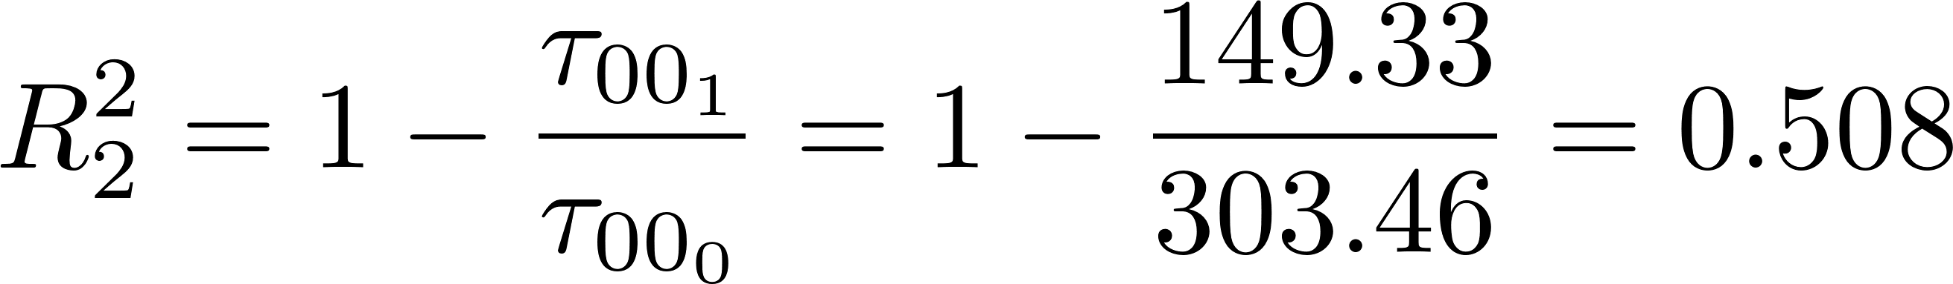
Level 2 Variance Reduction
How much does τ₀₀ shrink from Model 0 to Model 1?

Slide 28



Level 1 Variance Reduction
How much does $σ_{e}^{2}$ shrink from Model 0 to Model 1?
Why was there no Level 1 variance reduction?
There were no Level 1 predictors.

